Slide 1
[your name and title]

Slide 2
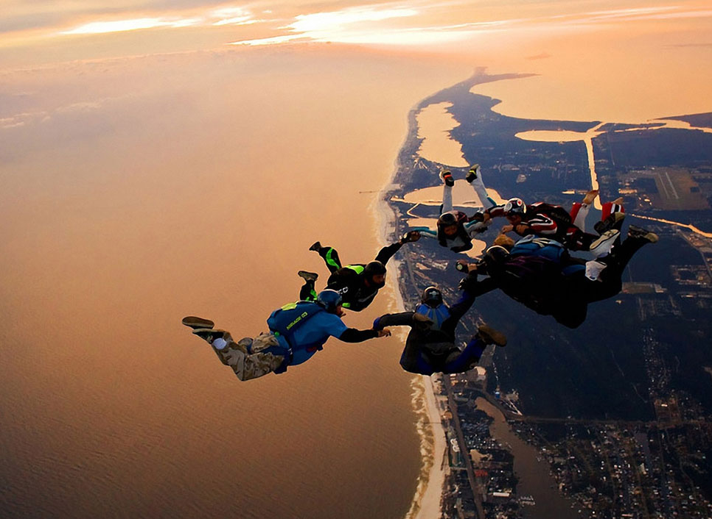
thrilling, inspiring and different learning experience

Slide 3
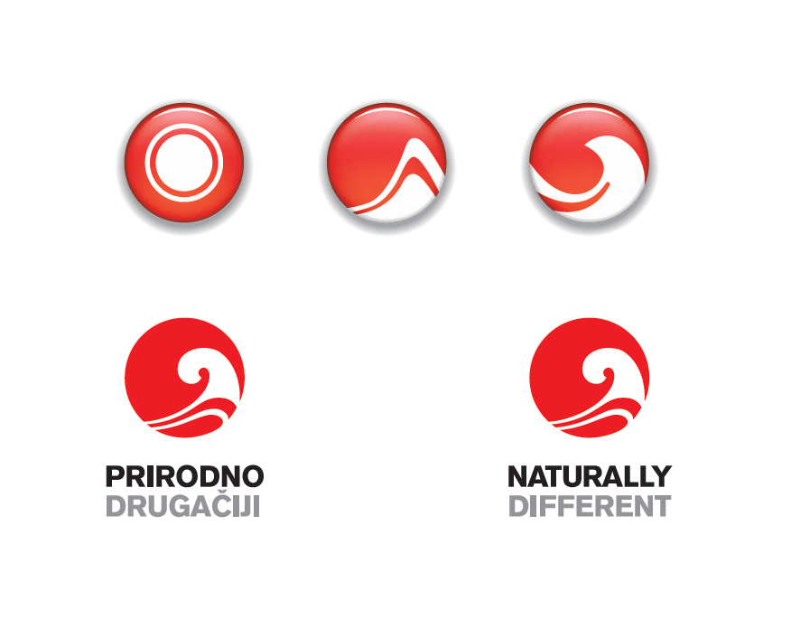
AG CULTURE & VALUES

Slide 4
WHAT IS ADVENTURE?
International leadership development program for young professionals and managers from all over the Atlantic Grupa.
WHY IT IS CALLED ADVENTURE?
It is a "journey into innovation, learning and execution" and asked of the participants
to learn by working on strategic business projects in international team;
to strengthen their visibility and build their network by working with top executives, prime experts and peers from all over AG;
to ask themselves some important questions which will raise their self-awareness and understanding the meaning of being a leader.
Notes:
BENEFITS FOR AG

Slide 5
WHAT WERE WE LOKING FOR?
2 - 5 years of professional/working experience - at least one year within AG
direct manager clearly in favor of application
level of English allowing for active participation
prepared to move abroad
motivation to grow and engage in own development
feeling the need to learn
being keen on working with fellow colleagues from other countries and divisions
having the passion and capacity to „step out of the box" and put new experiences into practice

Slide 6
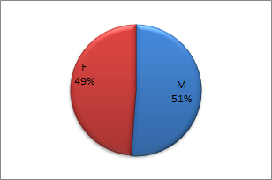
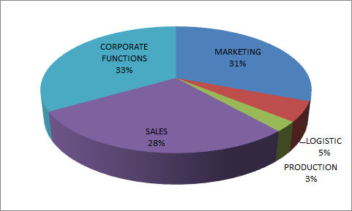
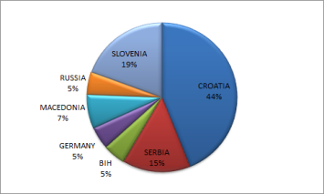
WHAT WE GOT?
APPLICATION INNITIALLY RECEIVED
entered selection process
CHOOSEN ONES
Notes:
NEŠTO O SELEKCIJI

Slide 7
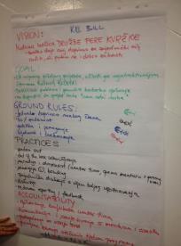
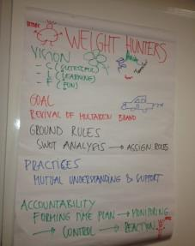
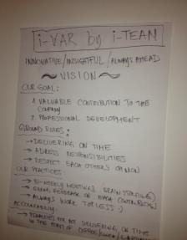
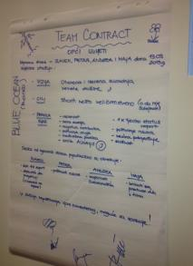
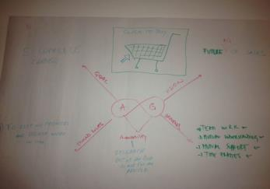
AT THE CORE OF ADVENTURE THERE ARE REAL STRATEGIC PROJECTS PUT FORWARD AIMED AT ENSURING INNOVATION FOR THE GROUP, DEALING WITH KEY BUSINESS ISSUES
Notes:
OTKUDA PROJEKTI, FORMIRANJE TIMOVA, LADA , LAP DANCE

Slide 8
TEAM SUPPORT
TEAM MENTOR – ”co-pilot seat”; to advise and hands down knowledge and experience, to give direction and regular feedback; to challenge the team and set expectations
TEAM COACH – “sideline support” to the team, help in maintaining effective team work and helping members in raising awareness of the learning process
WORKSHOP CONTENT PROVIDERS – effectively conducting workshop content and connecting workshop content with project workflow
PROGRAM MANAGER – professional support in handling possible resources and/or logistic issues and acting as “liaison” between all partners in the program
Adventure Events were the backbone of the Adventure journey - 3 major ones (DISCOVERY (Project Management), CHALLENGE (Team Work) and DELIVERY (Presentation Skills)

Slide 9
EVALUATION
INDIVIDUALS
PROJECTS
Notes:
PROJECT PROPOSAL PRESENTATIONS, EVALUATION OF THE CANDIDATES (MENTOR &COACH, MOTIVATION, STRENGHTS, DEVELOPMENT AREAS)
EVALUATION OF PROJECTS – SMC PRESENTATION (GENERAL IMPRESSION, WHAT WAS RIGHT, WHAT SHOULD BE DONE DIFFERENTLY)

Slide 10
IMPLEMENTATION
PROJECTS READY FOR IMPLEMENTATION – TOOK OVER BY THE BUSINESS
TO BE ADDITIONALLY RESEARCHED
DECLINED, ONE BECAUSE OF BUSINESS PRIORTITIES, ONE BECAUSE OF INSUFICIENT DATA
CANDIDATE REPORTS AND CANDIDATE DEVELOPMENT PLANS

Slide 11
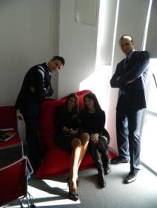
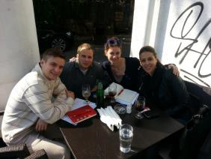
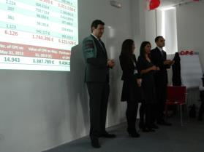
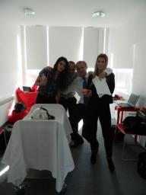
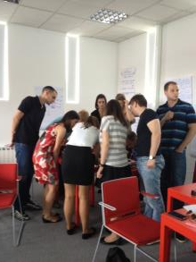
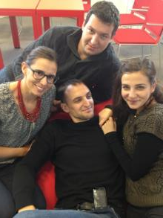
WHAT WAS IN IT FOR THEM?
Notes:
Specificnosti timova – nema vođe, nisu većinom prošli sve faze razvoja tima, lack of business skills; PROCJENA MENTORA

Slide 12
THANK YOU

